Slide 1


SEYEDAHMAD MOUSAVIHAGHDOUST
2024-F

Slide 2

Outline
Executive Summary
Introduction
Methodology
Results
Conclusion
Appendix

Slide 3
Executive Summary
Summary of methodologies
Summary of all results

Slide 4
Introduction
Project background and context
Problems you want to find answers

Slide 5

Section 1

Slide 6
Methodology
Executive Summary
Data collection methodology:
Data was available on a csv file.
Perform data wrangling
Data has been satandardized using preprocessing.StandardScaler mode
Perform exploratory data analysis (EDA) using visualization and SQL
Perform interactive visual analytics using Folium and Plotly Dash
Perform predictive analysis using classification models
Four classification models (Decision tree, support vector machine, logistic regression, KNN) has been built and best parameters was found by GridSearchCV and their accuracy was found by score method using test data.

Slide 7
Data Collection
Data have been collected through SpaceX API and webscraping the SpaceX Wikipedia page. These data has been integrated in a csv file for being used in the notebook.
SpaceX API
Json response
Panda’s dataframe
Csv file

Slide 8
Data Collection – SpaceX API
Present your data collection with SpaceX REST calls using key phrases and flowcharts
rockets api: requests.get("https://api.spacexdata.com/v4/rockets/"+str(x)).json()
lunchpads api: requests.get("https://api.spacexdata.com/v4/launchpads/"+str(x)).json()
payloads api: requests.get("https://api.spacexdata.com/v4/payloads/"+load).json()
cores api: requests.get("https://api.spacexdata.com/v4/cores/"+core['core']).json()
launche history api: requests.get("https://api.spacexdata.com/v4/launches/past")
This is GitHub URL of the completed SpaceX API calls notebook:
https://github.com/ahmadmsvh/IBM-data-science-course/blob/main/capstone/jupyter-labs-spacex-data-collection-api.ipynb
rockets api
Append rockets to data frame
Call lunchpads api
Call rockets api
Append launch pads to data frame
Append cores to data frame
Call cores api
Append payloads to data frame
Call payloads api
Append cores to data frame
Call launche history api
append launche history to dataframe

Slide 9
Data Collection - Scraping
Data has been extracted an been placed in the datafram using beautiful soup library following the chart.
bs=BeautifulSoup(requests.get("https://en.wikipedia.org/w/index.php?title=List_of_Falcon_9_and_Falcon_Heavy_launches&oldid=1027686922").text)
html_tables = bs.find_all('table')
GitHub URL of the completed web scraping notebook:
https://github.com/ahmadmsvh/IBM-data-science-course/blob/main/capstone/jupyter-labs-webscraping.ipynb
Get spaceX wikipedia page assign it to response
Create beautiful soup object of response.text
Extract Tables of beautiful object
Select the third table from extracted tables
Extract eech row using tr tags and datas using td tags and place it in related plase in dataframe
Call payloads api
Get desitred columns name using the table and th tags of it

Slide 10
EDA with Data Visualization
Summarize what charts were plotted and why you used those charts
We used a scatter plot for showing FlightNumber vs. PayloadMass relations. Then using a scatter chart we see that different launch sites have different success rates. Then we plot a scatter chart to show different flight numbers vs launch sites and success status using colors. Then We also show the relationship between launch sites and their payload mass and success status using color using scatter plot. Next, we show relationship between success rate and orbit type using a scatter plot again. Next a bar chart to find which orbits have high sucess rate. After that we show relationship between FlightNumber and Orbit type using scatter plot again and then FlightNumber vs Orbit vs success state as color in a scatter plot again. Then a line graph shoing that the sucess rate since 2013 kept increasing till 2020.
GitHub URL:
https://github.com/ahmadmsvh/IBM-data-science-course/blob/main/capstone/jupyter-labs-eda-dataviz.ipynb.jupyterlite.ipynb

Slide 11
Data Wrangling
First we Import pandas and numpy Libraries then Create a landing outcome label from Outcome column in the dataframe
GitHub URL:
https://github.com/ahmadmsvh/IBM-data-science-course/blob/main/capstone/labs-jupyter-spacex-Data%20wrangling.ipynb

Slide 12
EDA with SQL
Using bullet point format, summarize the SQL queries you performed
the GitHub url:

Slide 13
Build an Interactive Map with Folium
Summarize what map objects such as markers, circles, lines, etc. you created and added to a folium map
Explain why you added those objects
To show some geographical patterns about launch sites we used folium library to create a folium map object with the coordinates of launch sites added to it. Then we Create and add folium.Circle and folium.Marker for each launch site on the site map then we created markers for all launch records. If a launch was successful (class=1), then we used a green marker and if a launch was failed, we used a red marker (class=0).
Then created a MarkerCluster object and for each launch result in spacex_df data frame, added a folium.Marker to marker_cluster.
Then we added a MousePosition on the map to get coordinate for a mouse over a point on the map. As such, while you are exploring the map, you can easily find the coordinates of any points.
Next we Drew a PolyLine between a launch site to the selected coastline point and showed the calculated distance on the map.
the GitHub URL:
https://github.com/ahmadmsvh/IBM-data-science-course/blob/main/capstone/lab_jupyter_launch_site_location.jupyterlite.ipynb

Slide 14
Build a Dashboard with Plotly Dash
Summarize what plots/graphs and interactions you have added to a dashboard
Explain why you added those plots and interactions
In the dashboard we used a dropdown menu to select the launch site and also we used a range slider to select the time desired time span.
For visualizations we made a pie chart to show success and faliur rate, and a scatter plot to show success state vs payload mass and showing corresponding booster version usng colors.
the GitHub URL:
https://github.com/ahmadmsvh/IBM-data-science-course/blob/main/capstone/lab_jupyter_launch_site_location.jupyterlite.ipynb

Slide 15
Predictive Analysis (Classification)
Summarize how you built, evaluated, improved, and found the best performing classification model
You need present your model development process using key phrases and flowchart
We made four models as SVM, Classification Trees, Logistic Regression and KNN. And found best Hyperparameter using GridSearchCV method. And we evaluate each model using score method and test data. Evaluations resulte in that the three of four models are equally qualified to used as our model.
First we standardized data and then split data to train/test collections.
the GitHub URL:
https://github.com/ahmadmsvh/IBM-data-science-course/blob/main/capstone/SpaceX_Machine_Learning_Prediction_Part_5.jupyterlite.ipynb

Slide 16
Results
Exploratory data analysis results
Interactive analytics demo in screenshots
Predictive analysis results
Accuracy for Logistics Regression method: 0.8333333333333334
Accuracy for Support Vector Machine method: 0.8333333333333334
Accuracy for Decision tree method: 0.7222222222222222
Accuracy for K nearsdt neighbors method: 0.8333333333333334

Slide 17

Section 2

Slide 18
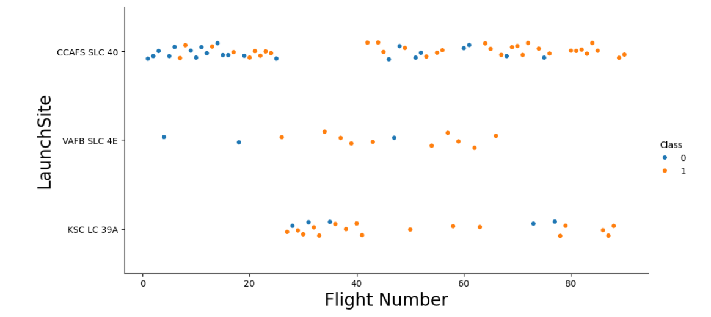
Flight Number vs. Launch Site
It is obvious that most flights and even most successful flights take placed in CCAFS SLC 40 launch site

Slide 19
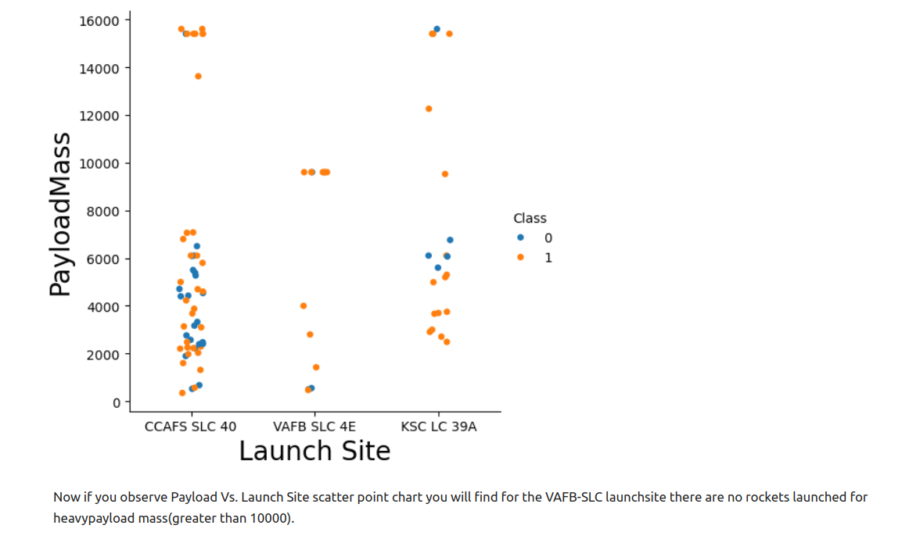
Payload vs. Launch Site

Slide 20
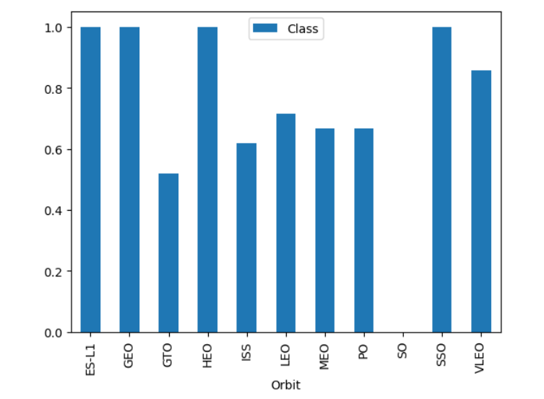
Success Rate vs. Orbit Type
This is abvious that there is no succeeded flight in SO orbit
And all flights in GEO, ES-11 and SSO orbits are succeeded

Slide 21
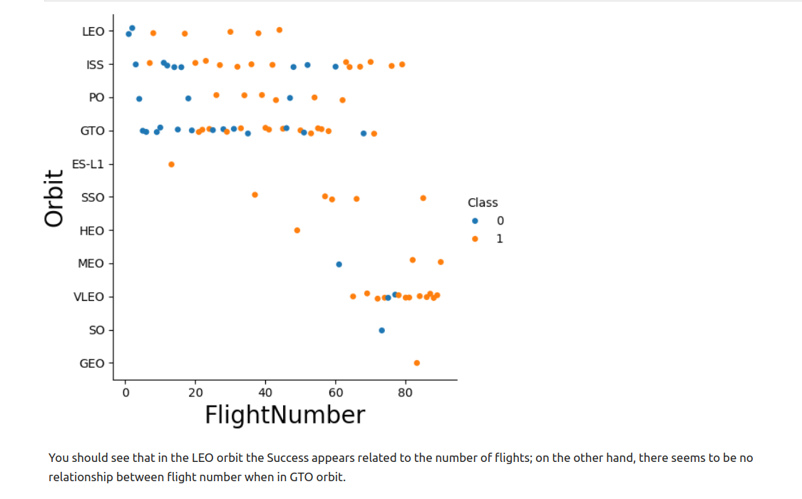
Flight Number vs. Orbit Type

Slide 22
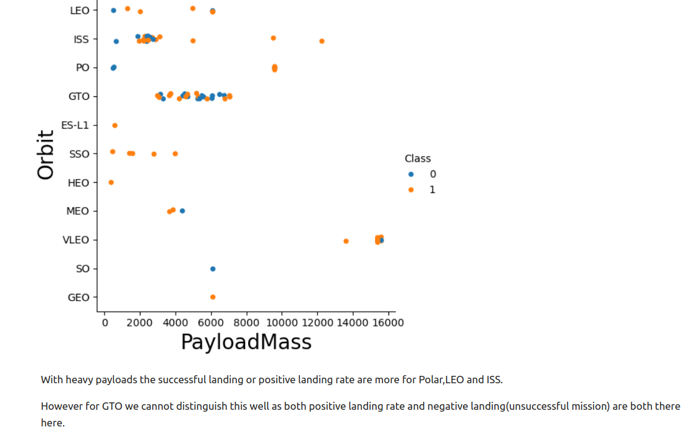
Payload vs. Orbit Type

Slide 23
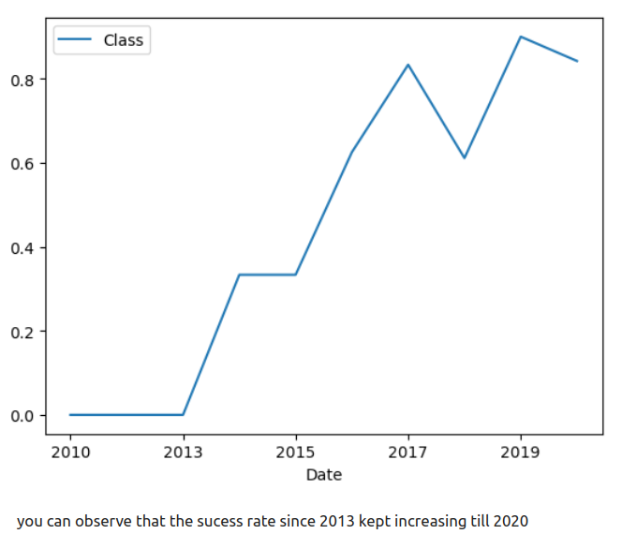
Launch Success Yearly Trend

Slide 24
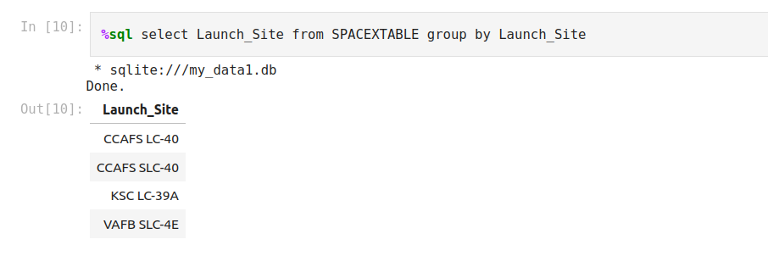
All Launch Site Names
There are four different launch site

Slide 25
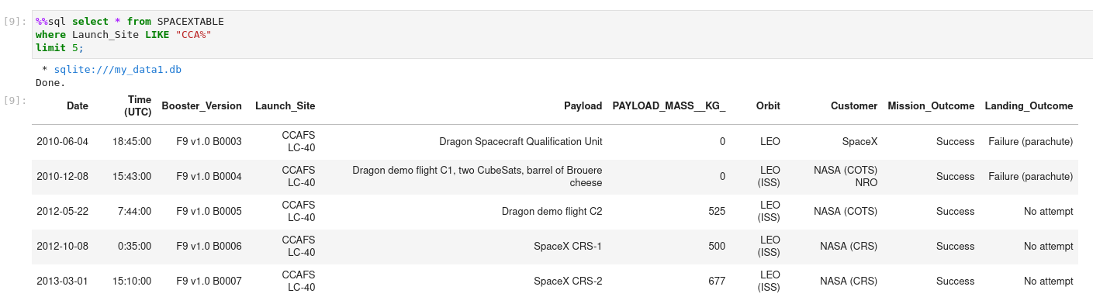
Launch Site Names Begin with 'CCA'

Slide 26
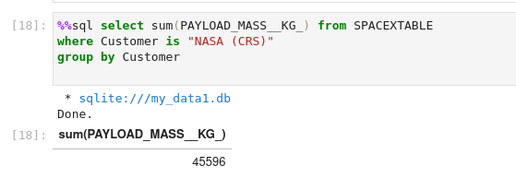
Total Payload Mass
As you can see total payload successfully delivered is 45596 kg

Slide 27
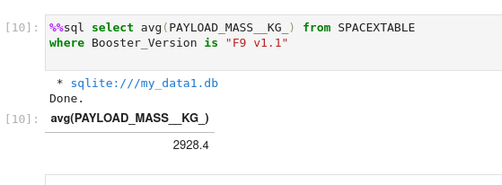
Average Payload Mass by F9 v1.1
Average payloud by booster version f9 v1.1 is 2928.4 kg

Slide 28
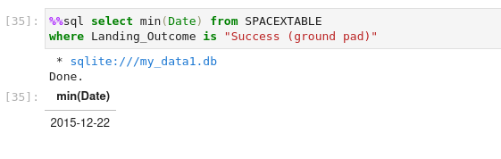
First Successful Ground Landing Date
The first successful groun landing performed on 2015-12-22

Slide 29
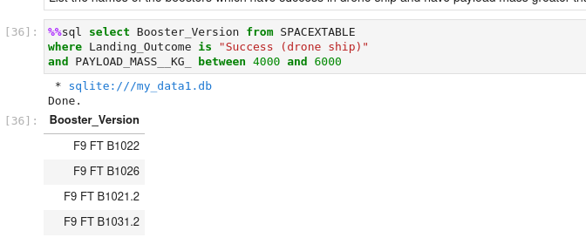
Successful Drone Ship Landing with Payload between 4000 and 6000
There are four booster version with success drone ship landing

Slide 30
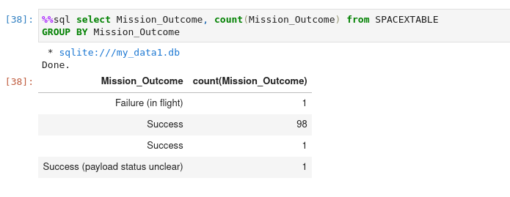
Total Number of Successful and Failure Mission Outcomes
There are 100 successful mission while 1 failured one

Slide 31
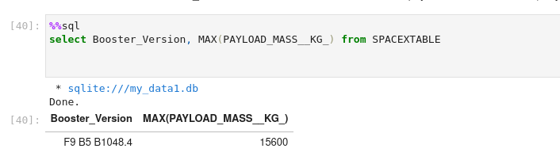
Boosters Carried Maximum Payload
Booster F9 B5 B1048.4 carried most loads

Slide 32
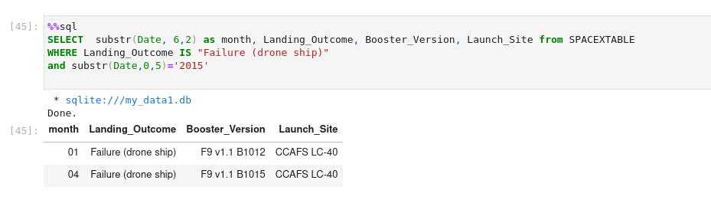
2015 Launch Records
There are two failure in 2015 with above information

Slide 33
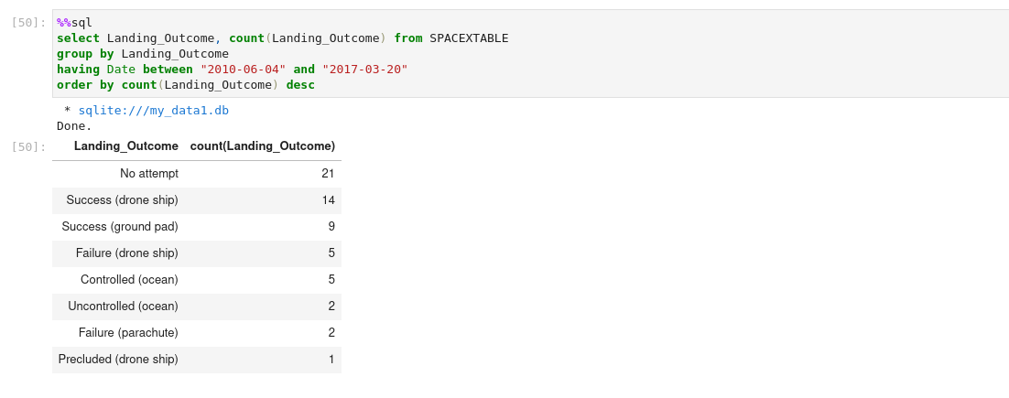
Rank Landing Outcomes Between 2010-06-04 and 2017-03-20

Slide 34

Section 3

Slide 35
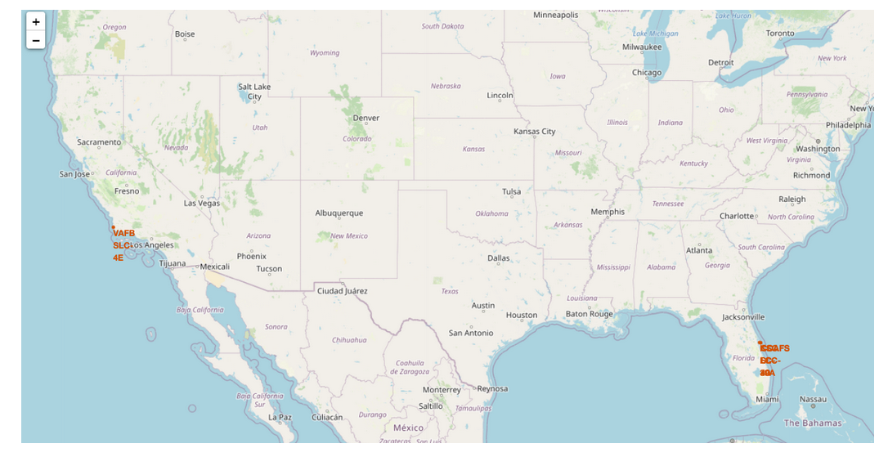
Launch site locations

Slide 36
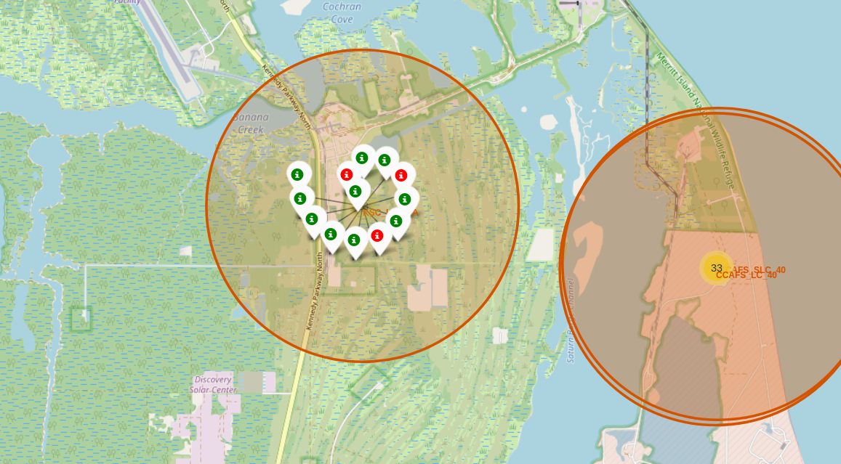
Labeled missions in KSC LC 39A

Slide 37
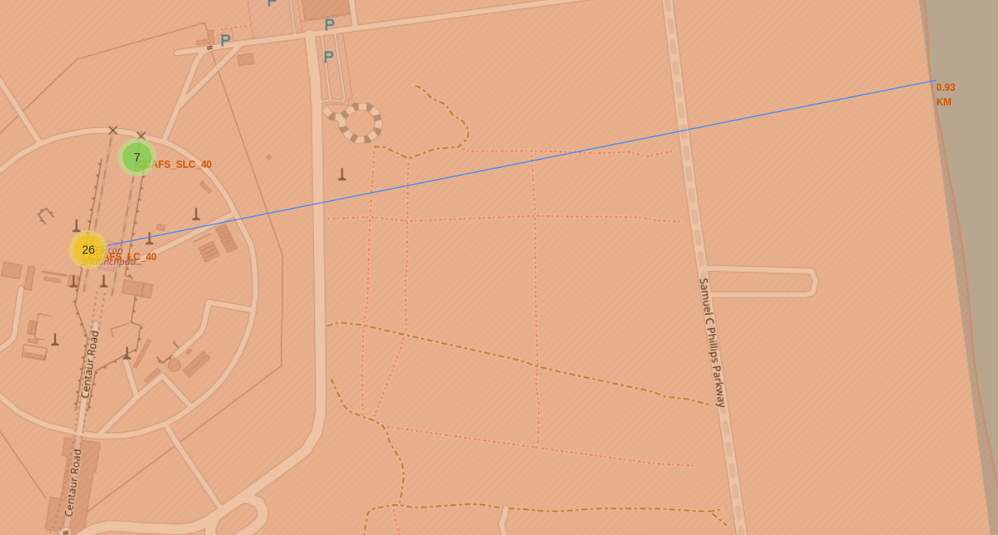
Distance to coastline

Slide 38

Section 4

Slide 39
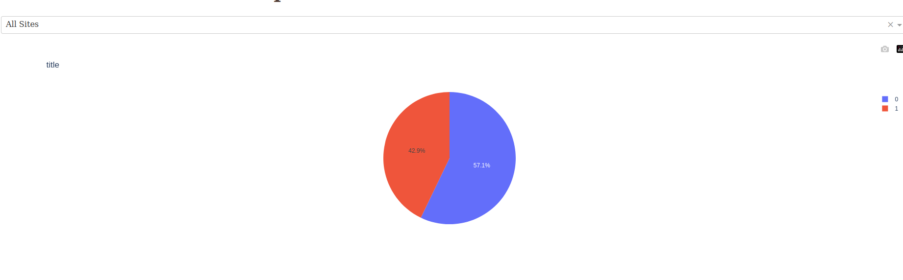
Succeeded and failured records
blue is related to class 0 that is failured and red is related to 1 that is succeeded

Slide 40
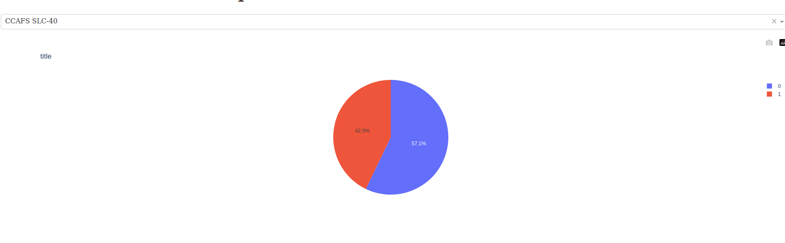
Pie chart of location with most successes
Location CCAFS SLC 40 with 42.9% successful outcome is on top

Slide 41
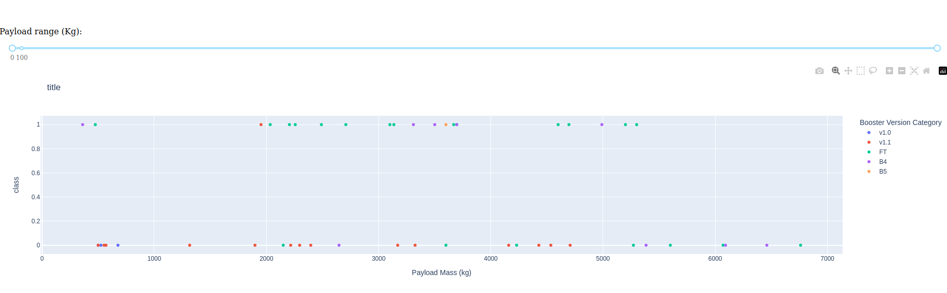
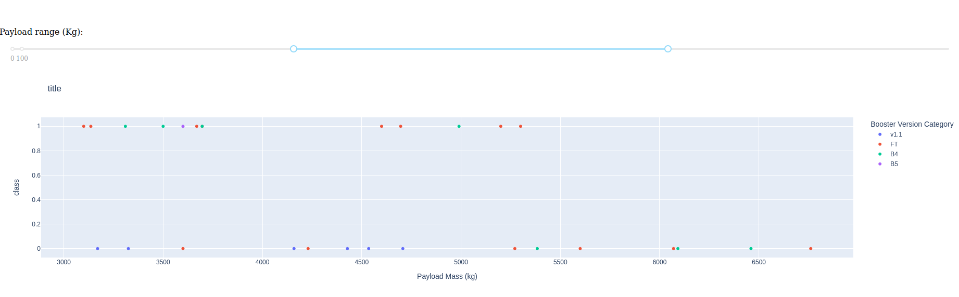
Scatter plots of outcome in to time ranges

Slide 42

Section 5

Slide 43
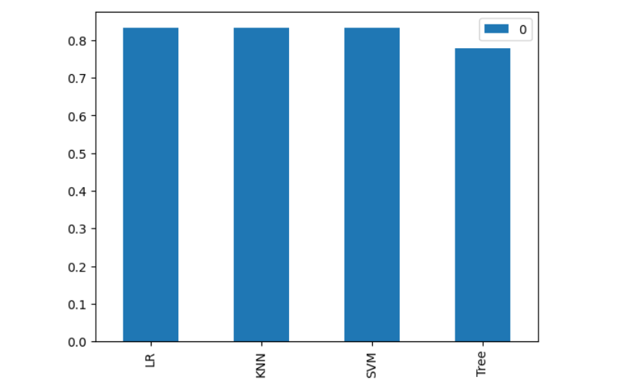
Classification Accuracy
As you can see LR, SVM and KNN have the same result that is 83.3% while Tree has the result of 77.8%. then we can choose one of those tree models.

Slide 44
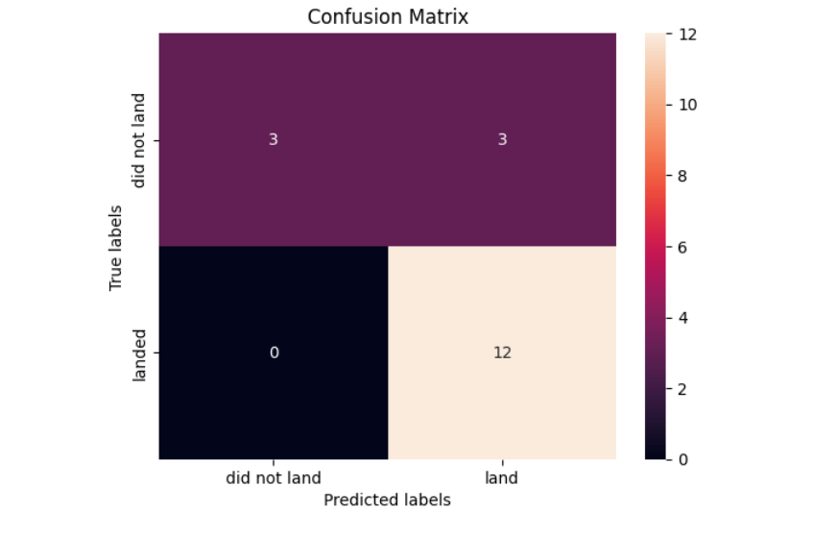
Confusion Matrix

Slide 45
Conclusions

Slide 46
Appendix
Include any relevant assets like Python code snippets, SQL queries, charts, Notebook outputs, or data sets that you may have created during this project

Slide 47


